Slide 1
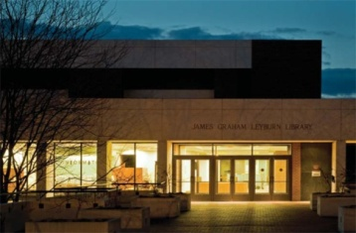
Getting Your Publications to the Masses: Using W&L’s Institutional Repository to Enhance Scholarly Communication Elizabeth Anne Teaff, MLIS August 31, 2009

Slide 2
Has anyone ever contacted you about getting a copy of one of your publications?
Have you noticed how some authors have their publications easily found on the Internet?
Have you ever thought about making your articles more easily available?

Slide 3
The University Library is beginning a pilot project to build a Institutional Repository of faculty publications
Allowing us to add your article(s) to the W&L Institutional Repository will make it searchable in Google Scholar and other search engines
This may enhance the impact factor of your publication(s) by increasing its accessibility and exposing it to a wider audience

Slide 4
What Is an Institutional Repository (IR) ?
Software that allows Institutions to :
Index/Organize, Create Workflow, Preserve/Store Digital Information for later Retrieval and Dissemination
Software that allows for preservation and access to digital content including text, images (TIFFs, JPEGs, MPEGs), data sets, journal articles, etc.
Provide alternative publishing model for faculty created content
Create permanent location to house content created and/or owned by the University
IR Best Practices:
Institutions should create collection policies
Commit to long-term preservation of materials in IR
IRs should include the richest metadata possible to allow items to be harvested by service providers (Google) so digital assets may be searchable on a global scale

Slide 5
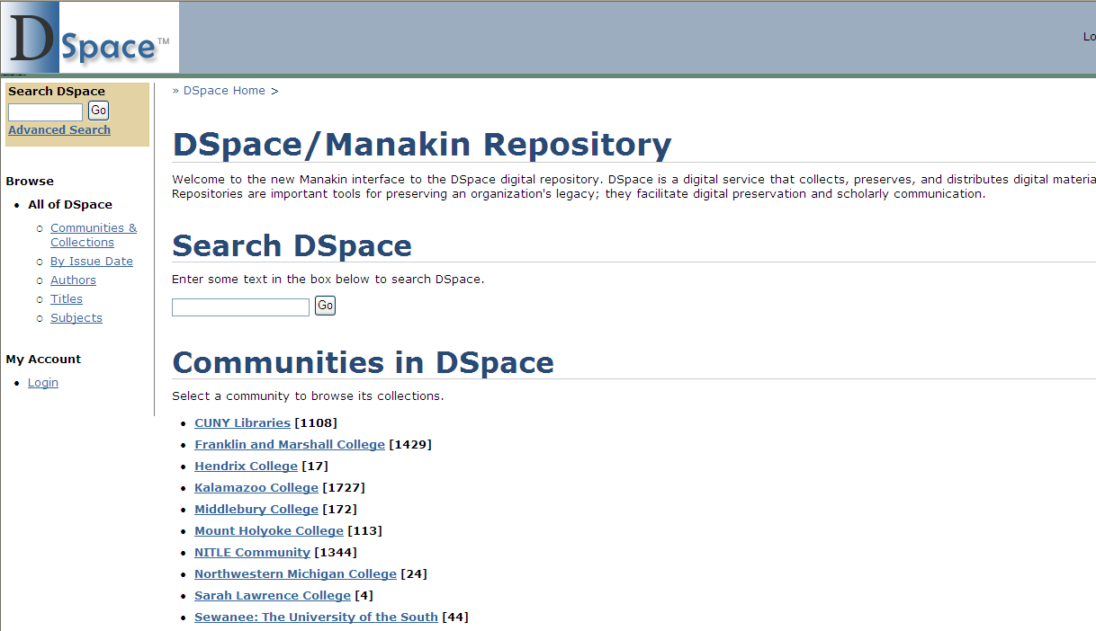
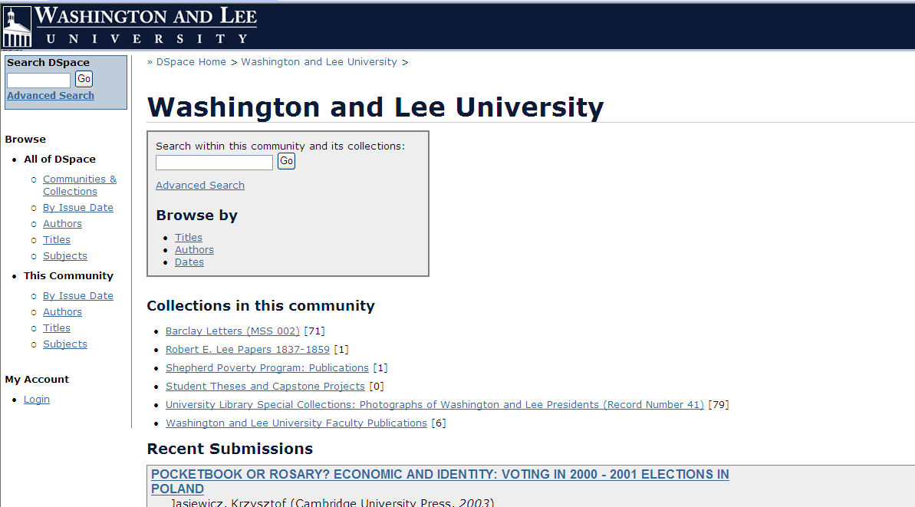
W&L’s Repository

Slide 6
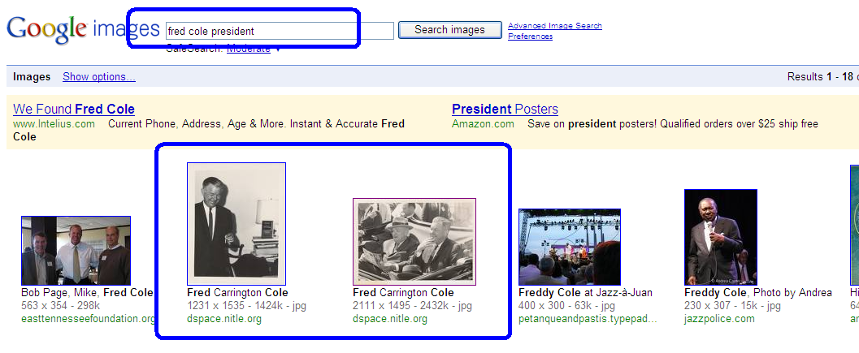
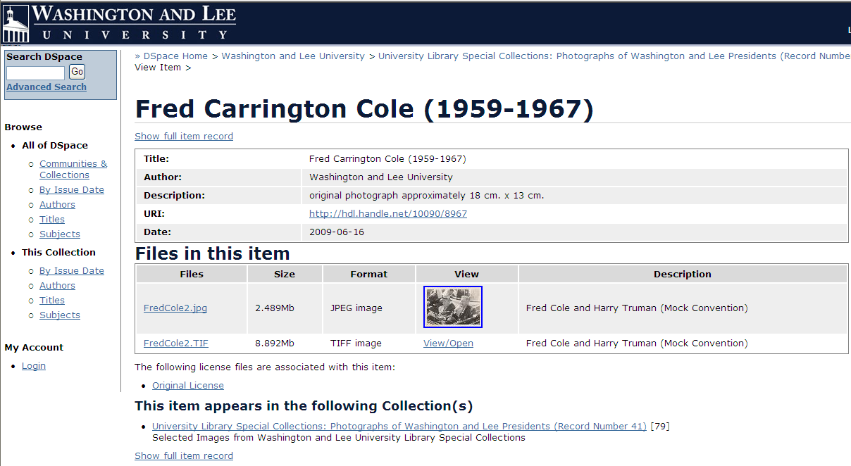
W&L’s Repository University Library Special Collections: Photographs of Washington & Lee Presidents (Record Number 41)

Slide 7
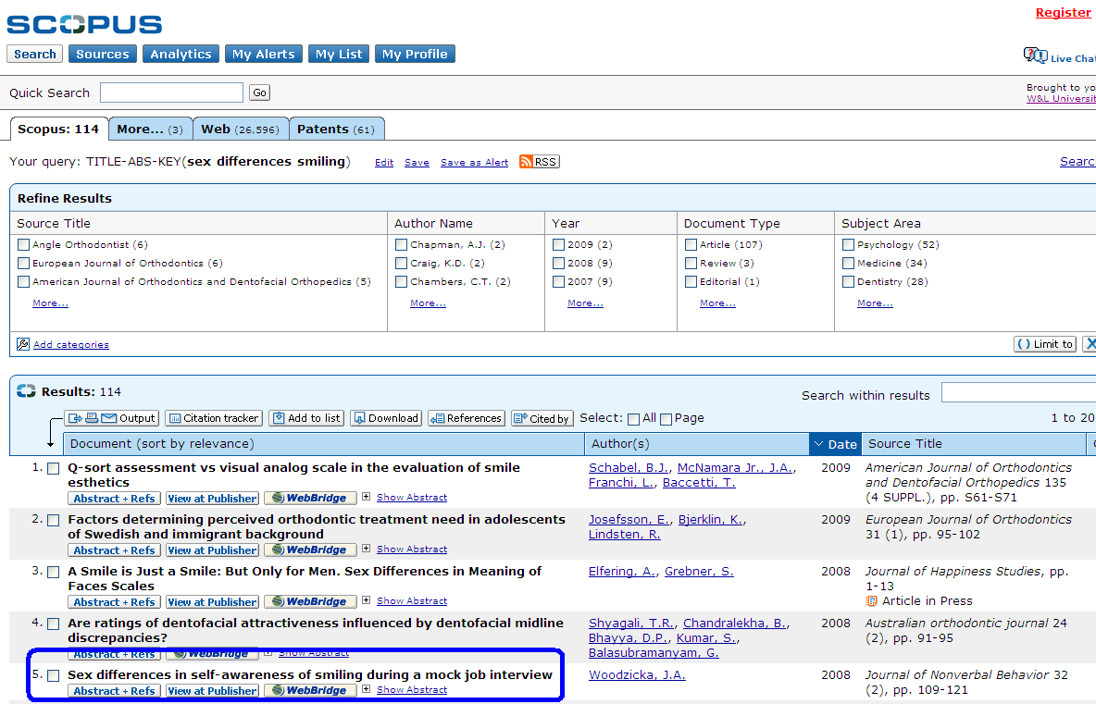
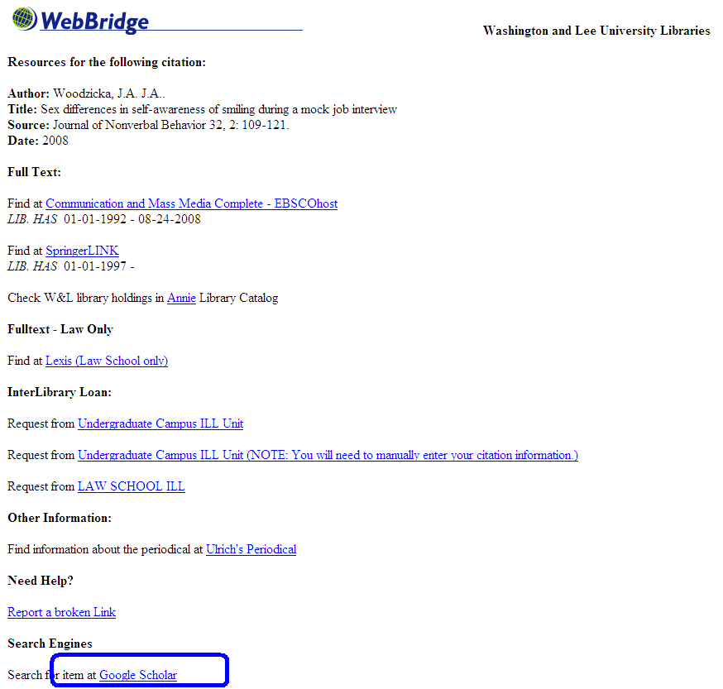
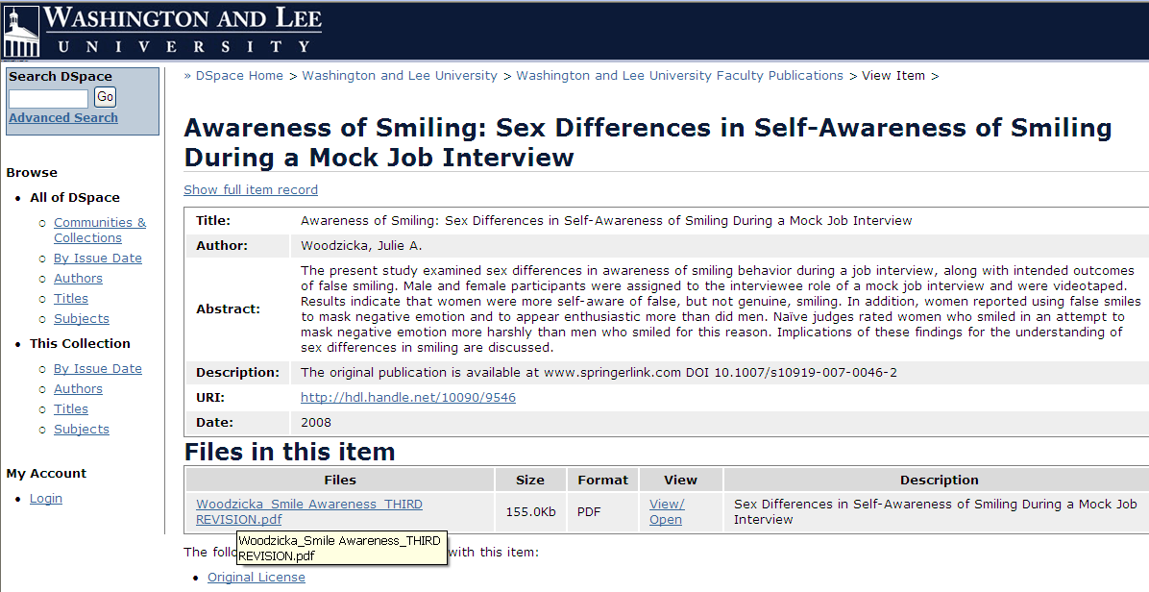
EXAMPLE of W&L Faculty Publication in the Repository

Slide 8
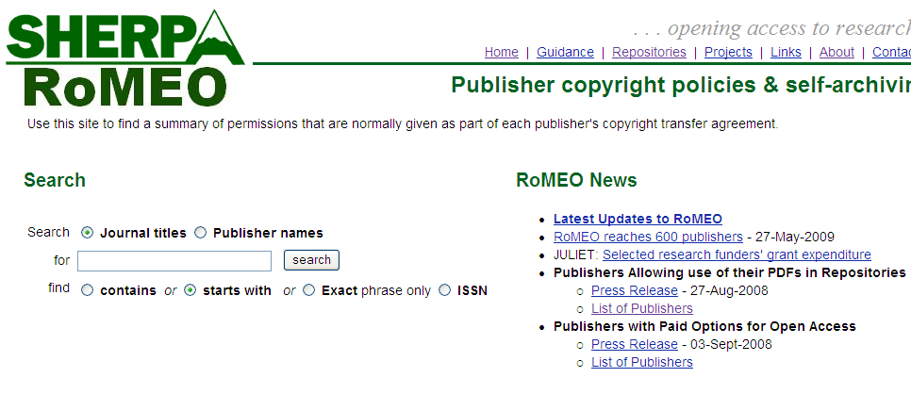
ROMEO
http://www.sherpa.ac.uk/romeo/
Determining your copyrights as an author
Database of publisher's copyright & archiving policies

Slide 9
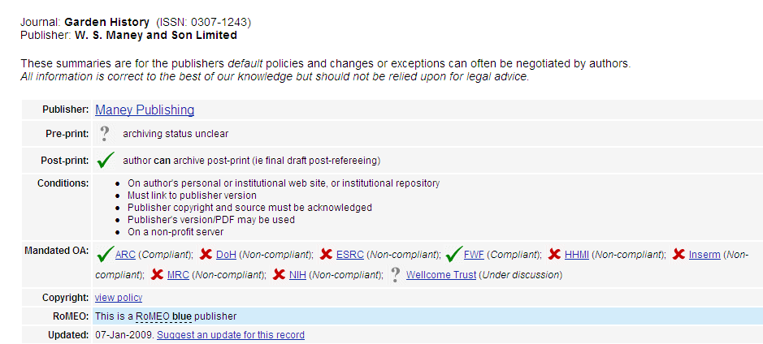
Example of Copyright Information from ROMEO

Slide 10
Archiving Policy Options
If your publications do not qualify for deposit in an Institutional Repository, we would like to have your conference presentations, or original teaching materials (e.g. illustrations, models, simulations, etc.).

Slide 11
If you are interested in this project, please send us your article(s) either in pre-publication form (as originally submitted to the journal for publication before the referee process) OR in post-referee form (final draft post-refereeing)
*USE ROMEO WEBSITE TO DETERMINE IF YOUR PUBLICATIONS QUALIFY:
http://www.sherpa.ac.uk/romeo/
An electronic version of your work can be emailed to teaffe@wlu.edu If you only have a hardcopy, you may drop it off at the Information Desk of the Leyburn Library or send it to us by Campus Mail; we will scan it and mail it back to your office
If you have any questions don’t hesitate to call us at (540) 458-8645 We look forward to working with you

Slide 12
Sources
PowerPoint Presentation: “Digital Repositories Using DSPACE.” NITLE Information Services Camp Workshop Session Two, June 4, 2009. Scott Hamlin, Director of Technology for Research and Instruction, Wheaton College.
NITLE DSPACE Services webpage. http://www.nitle.org/www/service_groups/3
SPARC Repository Resources webpage. http://www.arl.org/sparc/repositories/
PowerPoint Presentation: “Digitization Strategies, Technologies, and Practices.” NITLE Information Services Camp Workshop June 3, 2009. James Gehrt, Digitzation Center Coordinator, Mount Holyoke College.
“The Case for Institutional Repositories: A SPARC Position Paper.” Raym Crow. SPARC, 2002. (http://www.arl.org/sparc/bm~doc/ir_final_release_102-2.pdf)
SPARC Institutional Repository Checklist & Resource Guide. (http://www.arl.org/sparc/bm~doc/ir_guide__checklist_v1.pdf)

